Slide 1
Texture Mapping
Computer Graphics

Slide 2
Reading
Hearn & Baker, Chapter 10
Angel, Chapter 8
Watt, Chapter 8

Slide 3
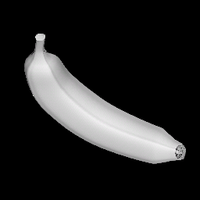
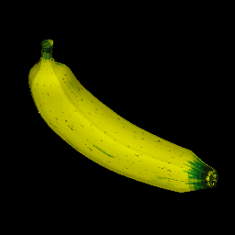
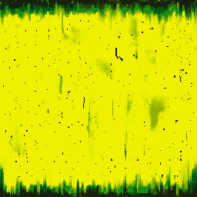
What Is Texture Mapping? (1)
Map a texture pattern onto the surfaces of an object
easily add details to an object
+
Texture mapped
object
3D object
Texture

Slide 4
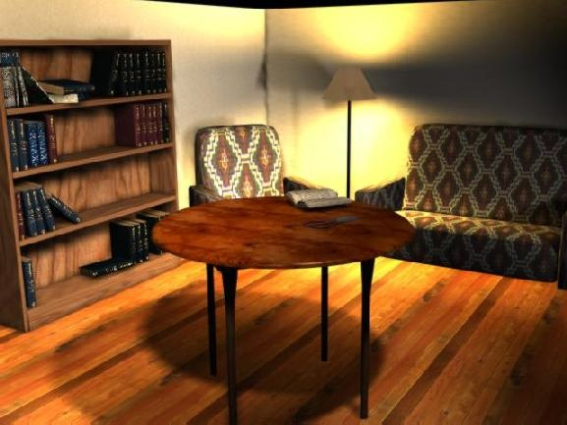
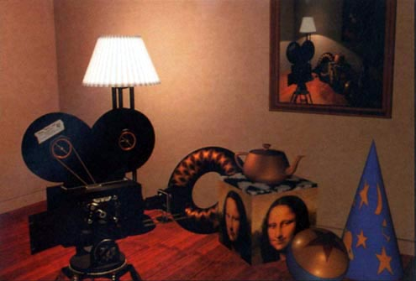
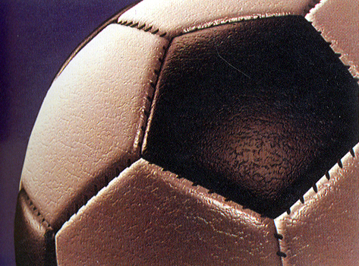
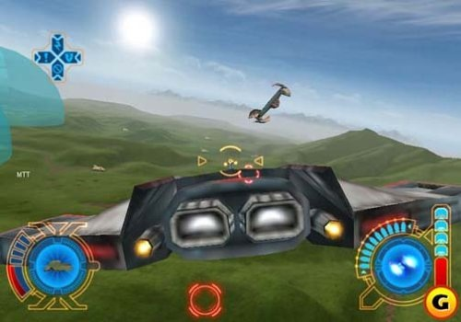
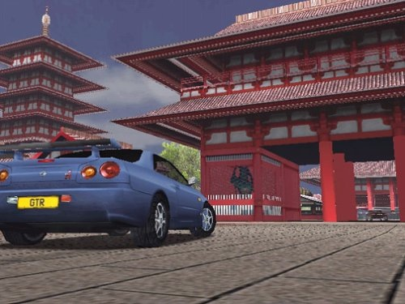
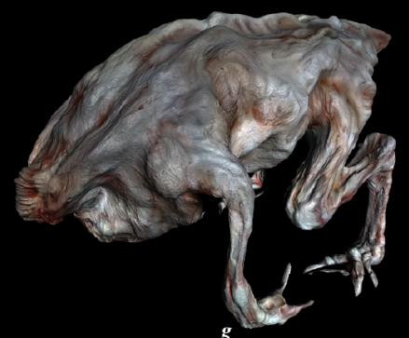
What Is Texture Mapping? (2)
Fundamental technique in computer graphics

Slide 5
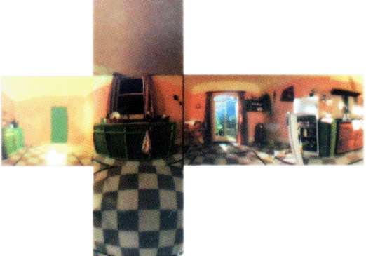
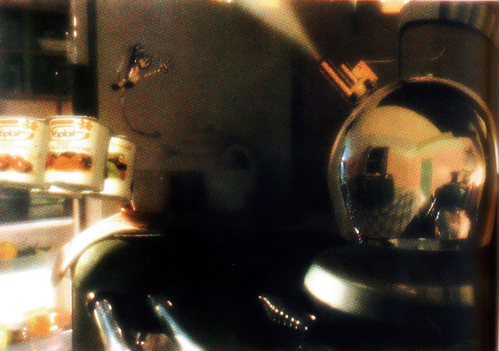
Using Textures
Color
Determining diffuse color components
Specular ‘color’
environment map
specular map
Normal vector perturbation
bump mapping
normal mapping
Displacement mapping
ex) Perturb a surface point
Transparency
ex) decorative pattern on a glass

Slide 6
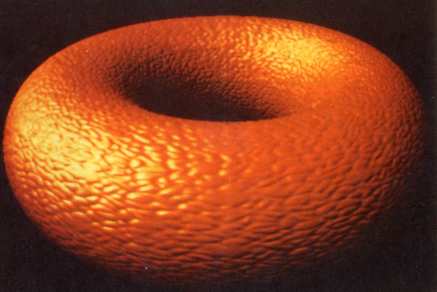
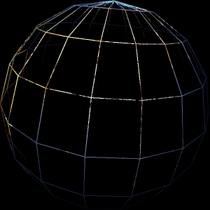
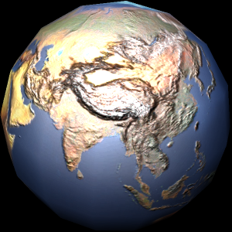
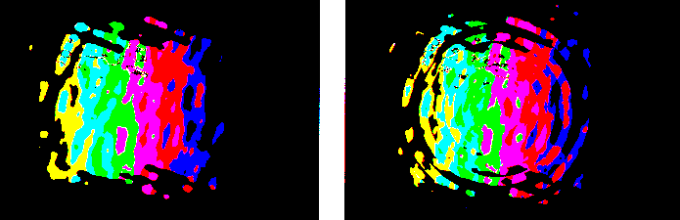
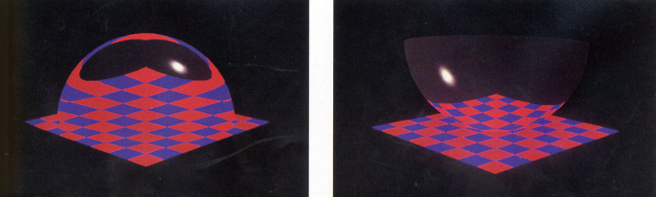
Using Textures
Color
Determining diffuse color components
Specular ‘color’
environment map
specular map
Normal vector perturbation
bump mapping
normal mapping
Displacement mapping
ex) Perturb a surface point
Transparency
ex) decorative pattern on a glass

Slide 7
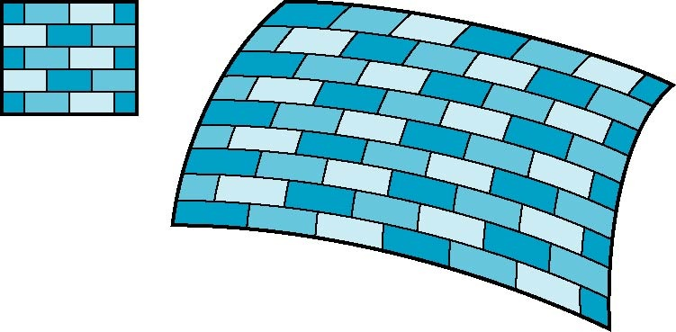
Is it simple?
Although the idea is simple---map an image to a surface---there are 3 or 4 coordinate systems involved
2D image
3D surface

Slide 8
Coordinate Systems
Parametric coordinates
May be used to model curves and surfaces
Texture coordinates
Used to identify points in the image to be mapped
Object or World Coordinates
Conceptually, where the mapping takes place
Window Coordinates
Where the final image is really produced

Slide 9
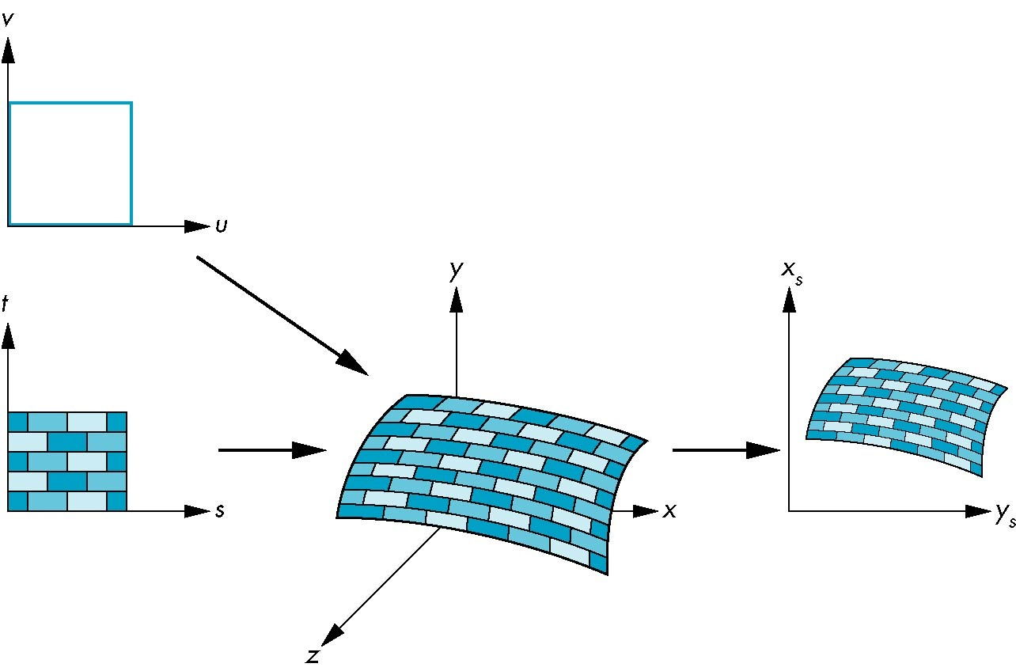
Texture Mapping
Parametric coordinates
window coordinates
texture coordinates
world coordinates

Slide 10
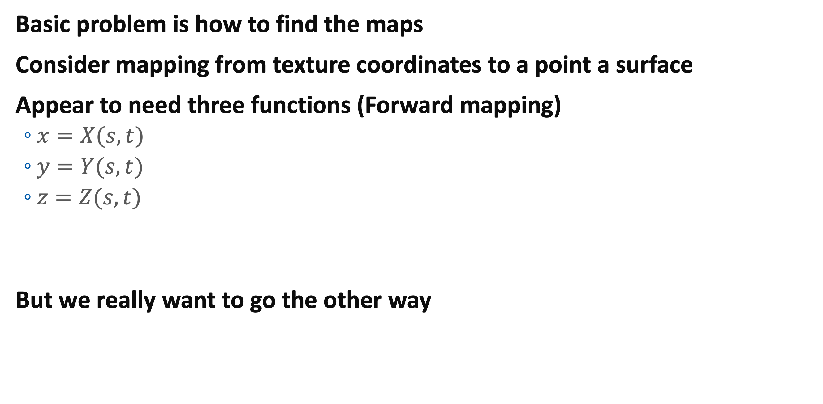
Mapping Functions
Basic problem is how to find the maps
Consider mapping from texture coordinates to a point a surface
Appear to need three functions (Forward mapping)
$x=X(s,t)$
$y=Y(s,t)$
$z=Z(s,t)$
But we really want to go the other way
(x,y,z)
t
s

Slide 11
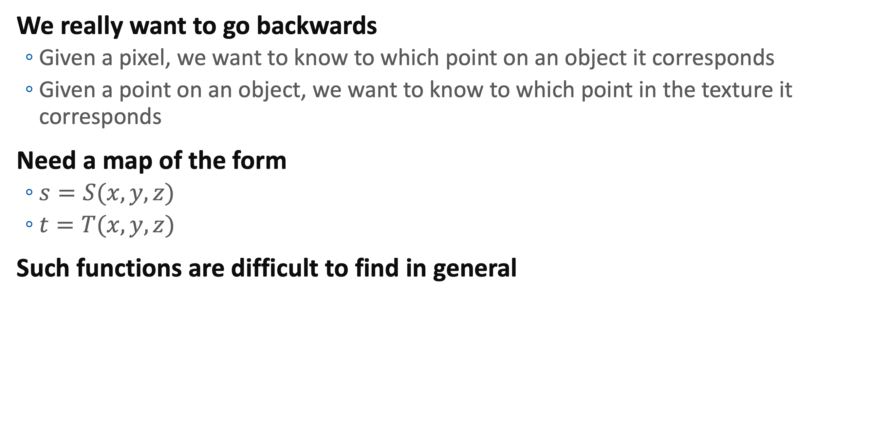
Backward Mapping
We really want to go backwards
Given a pixel, we want to know to which point on an object it corresponds
Given a point on an object, we want to know to which point in the texture it corresponds
Need a map of the form
$s=S(x,y,z)$
$t=T(x,y,z)$
Such functions are difficult to find in general

Slide 12
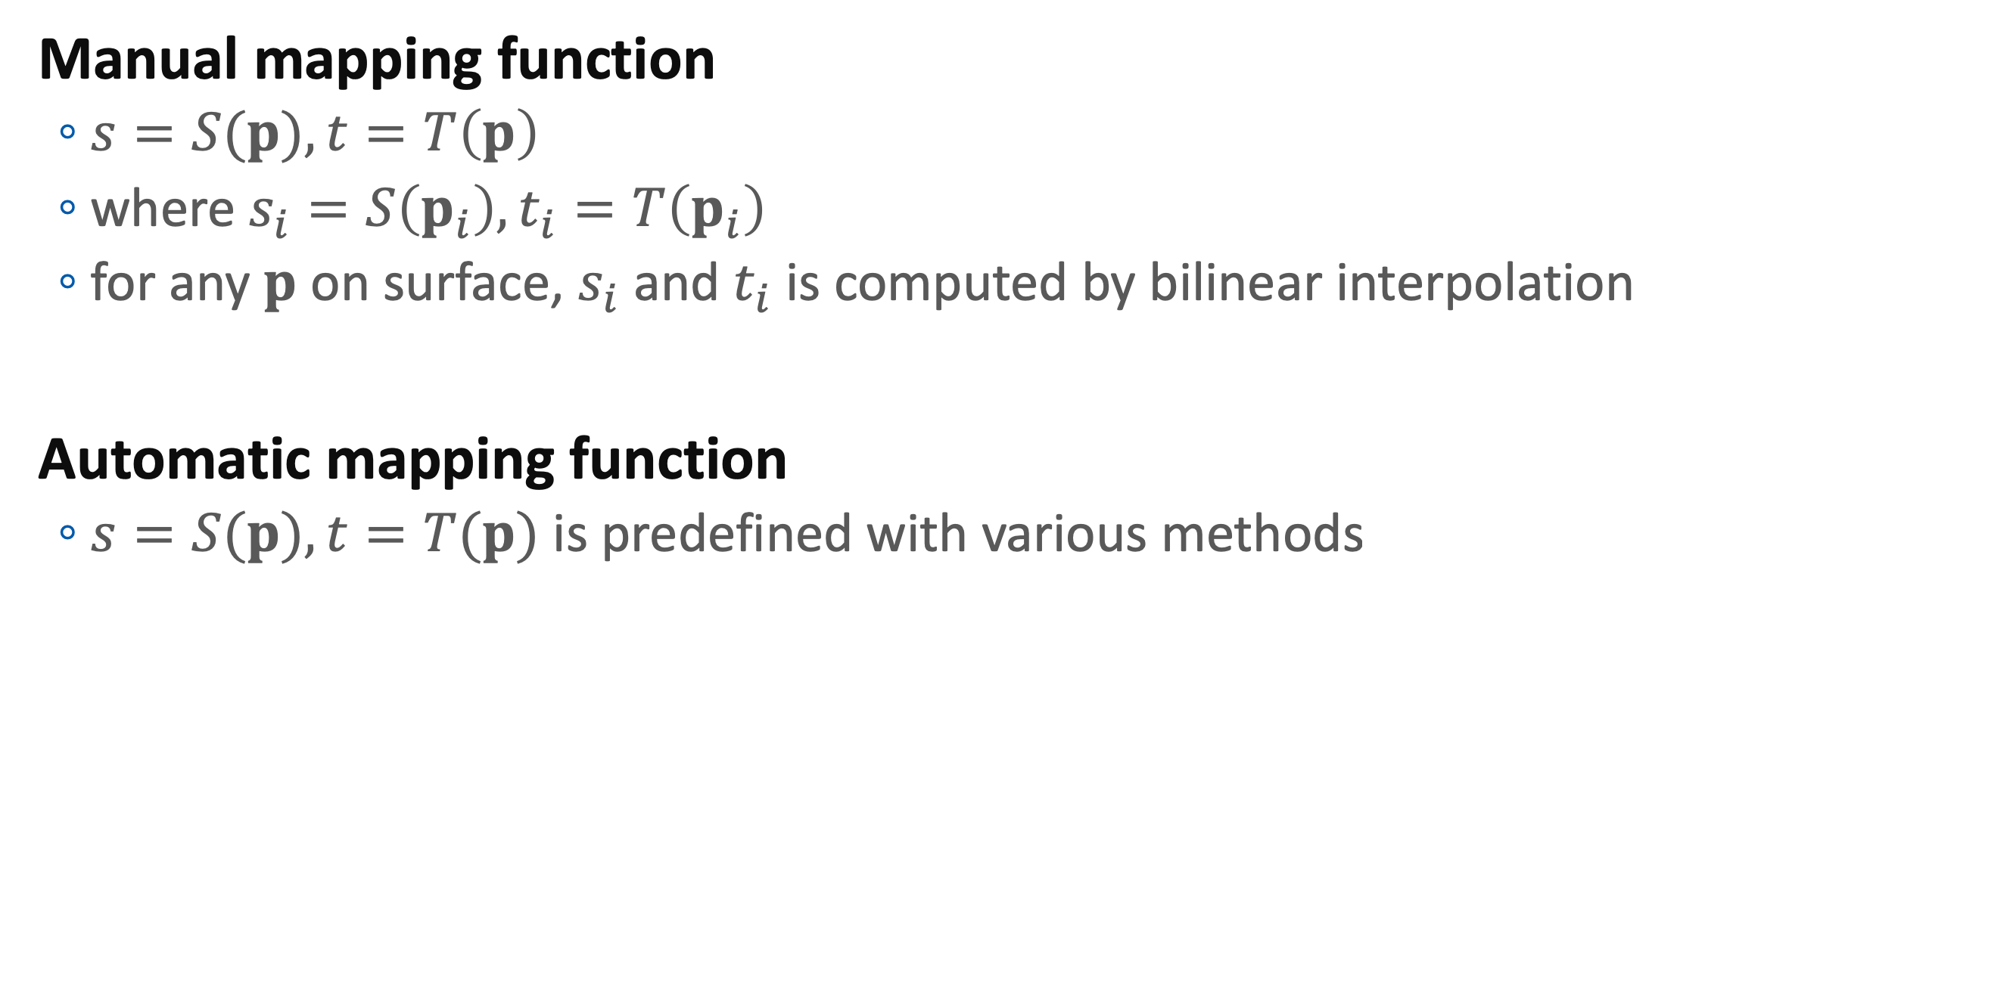
Manual vs Automatic
Manual mapping function
$s=S(p), t=T\left(p\right)$
where $s_{i}=S\left(p_{i}\right), t_{i}=T\left(p_{i}\right)$
for any $p$ on surface, $s_{i}$ and $t_{i}$ is computed by bilinear interpolation
Automatic mapping function
$s=S(p), t=T(p)$ is predefined with various methods

Slide 13
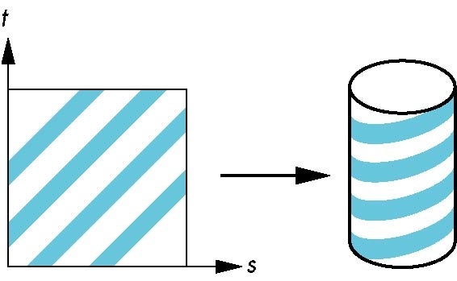
Two-part mapping
One solution to the automatic mapping problem is to first map the texture to a simple intermediate surface
Example: map to cylinder

Slide 14
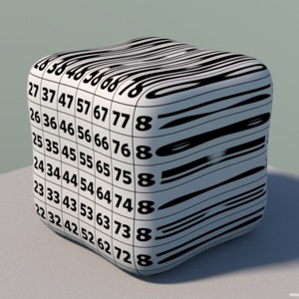
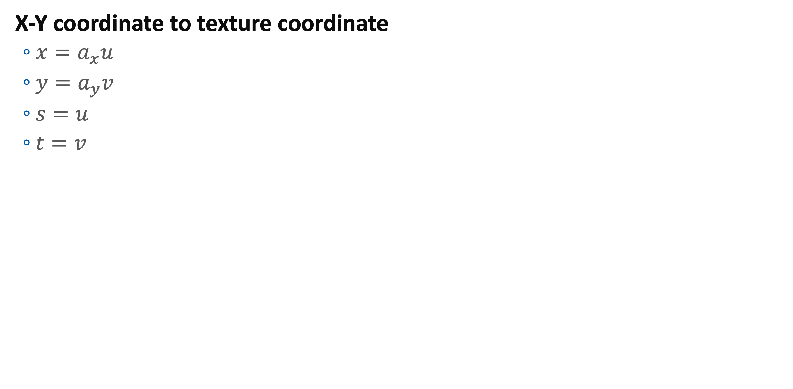
Planar Mapping
X-Y coordinate to texture coordinate
$x=a_{x}u$
$y=a_{y}v$
$s=u$
$t=v$

Slide 15
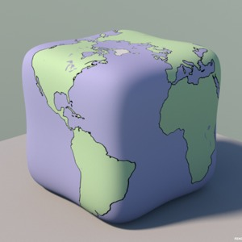
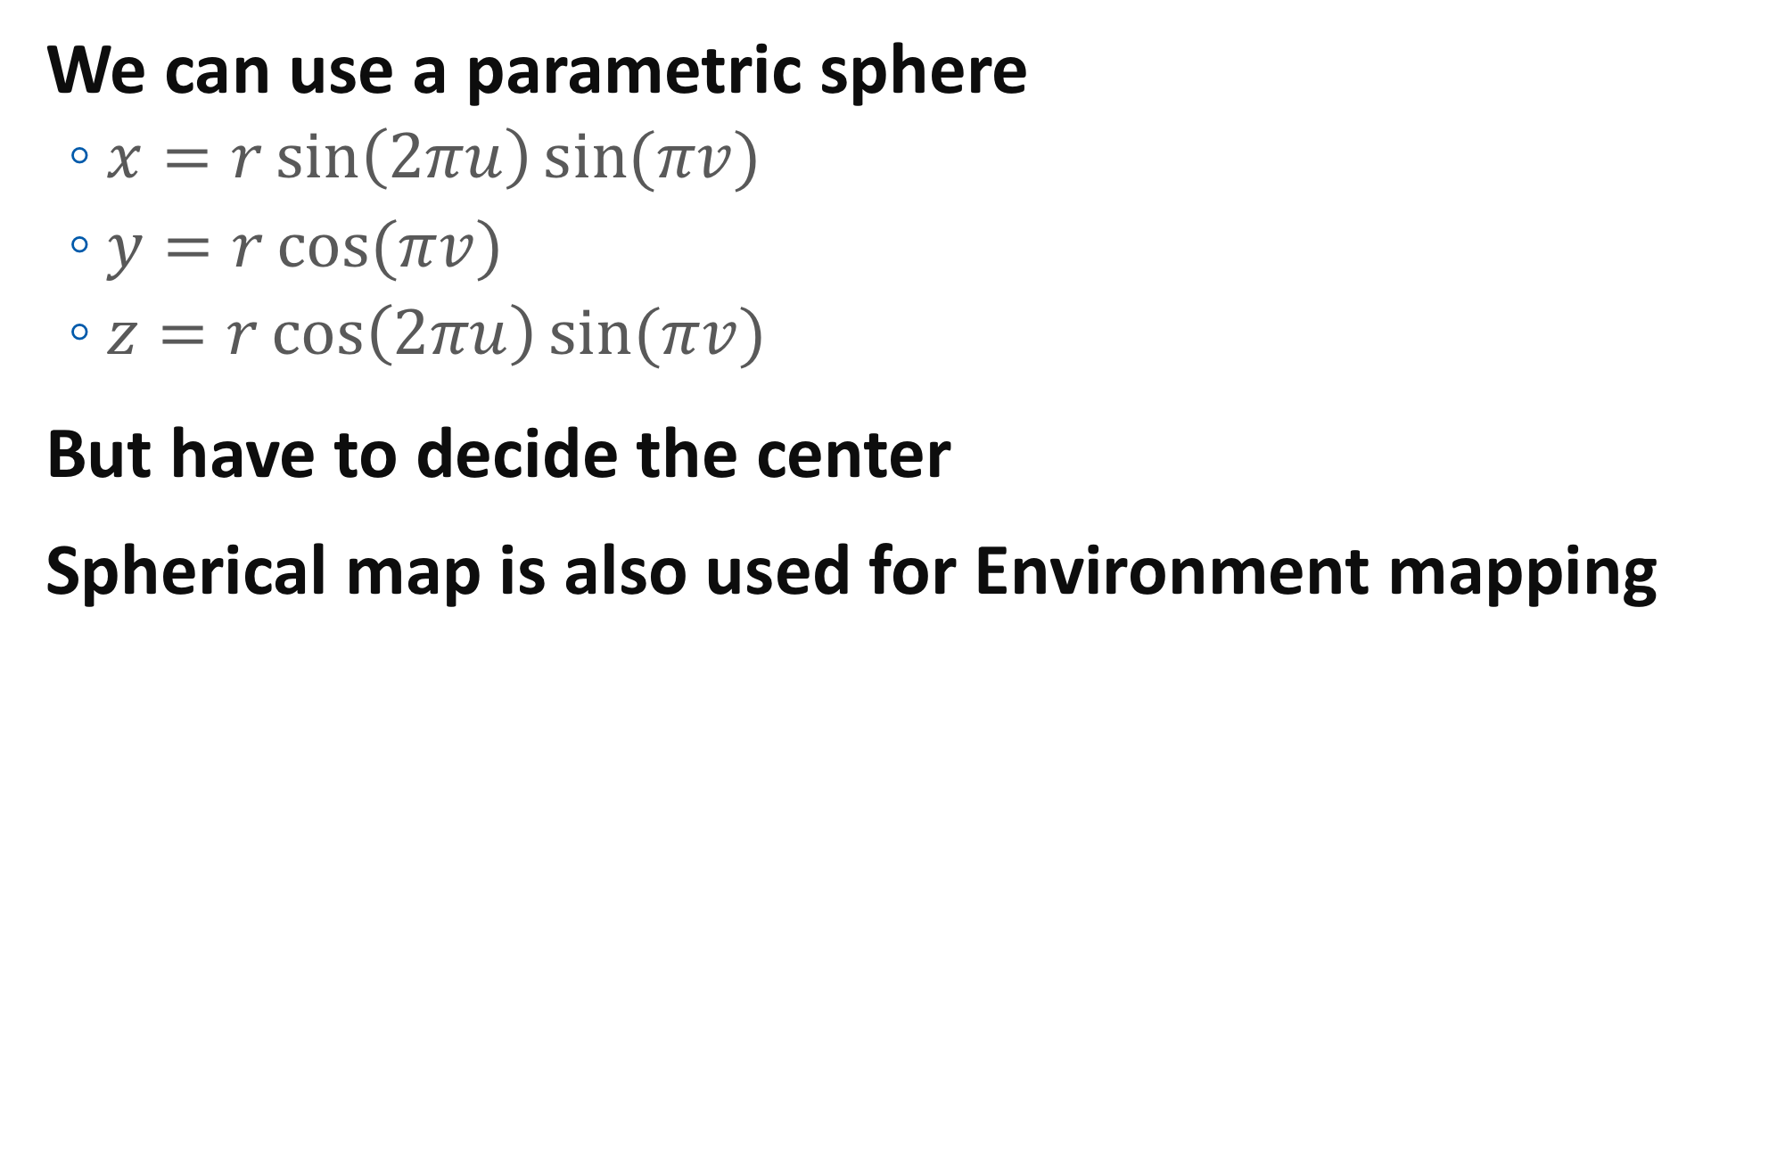
Spherical Map
We can use a parametric sphere
$x=r\sin\left(2πu\right)\sin{(πv)}$
$y=r\cos{(πv)}$
$z=r\cos\left(2πu\right)sin⁡(πv)$
But have to decide the center
Spherical map is also used for Environment mapping

Slide 16
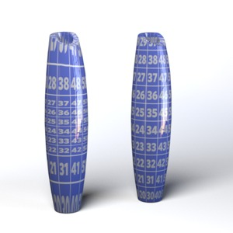
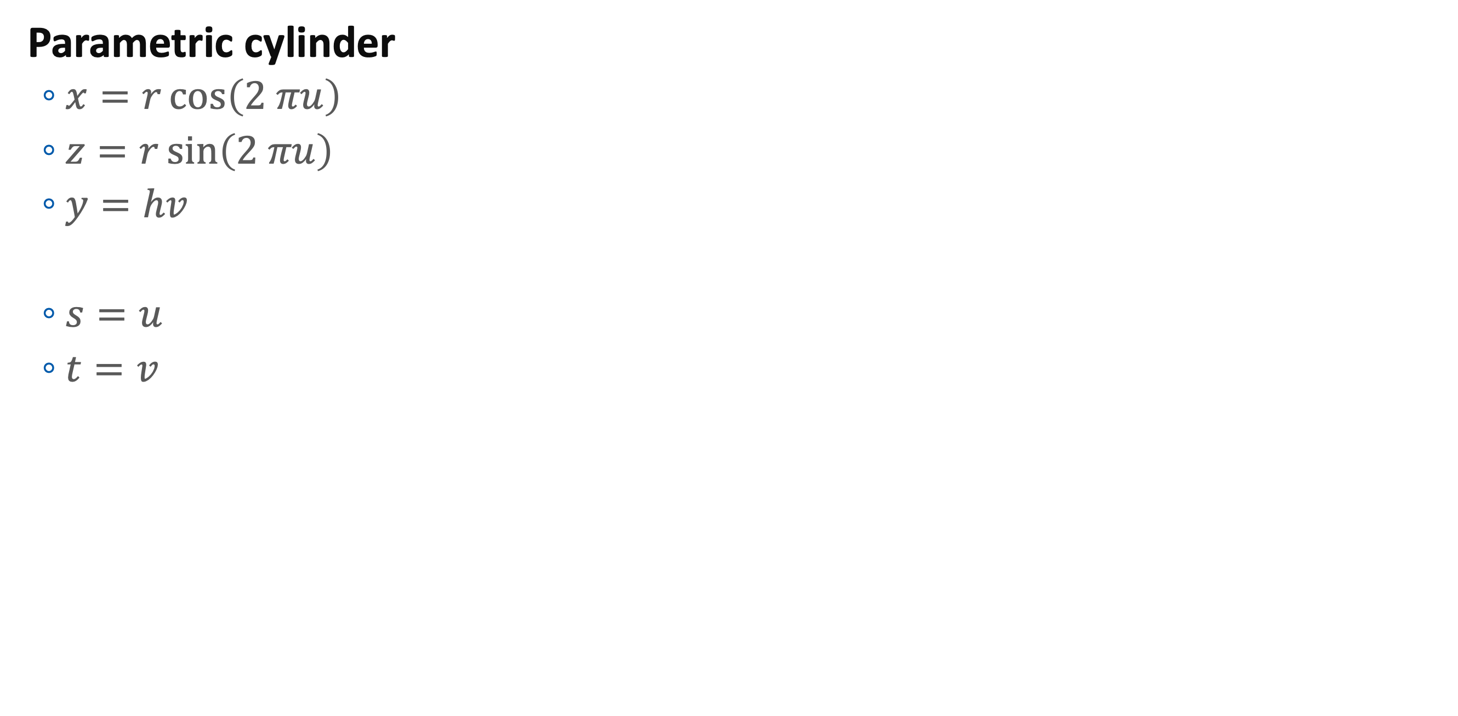
Cylindrical Mapping
Parametric cylinder
$x=r\cos\left(2 πu\right)$
$z=r\sin\left(2 πu\right)$
$y=hv$
$s=u$
$t=v$

Slide 17
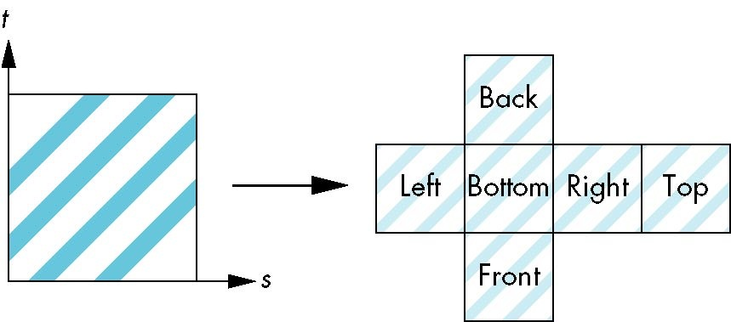
Box Mapping
Easy to use with simple orthographic projection
Also used in environment maps

Slide 18
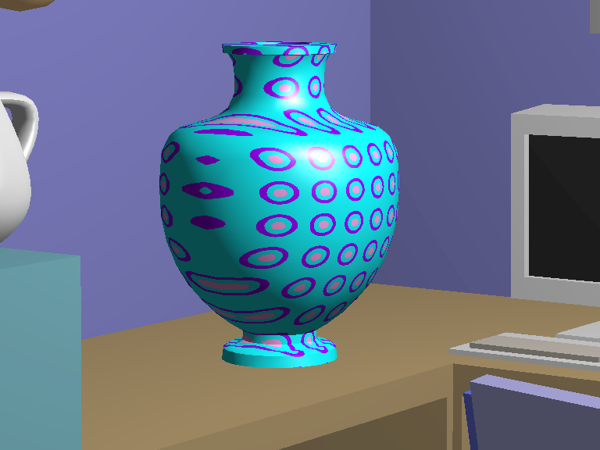
Planar Mapping Example

Slide 19
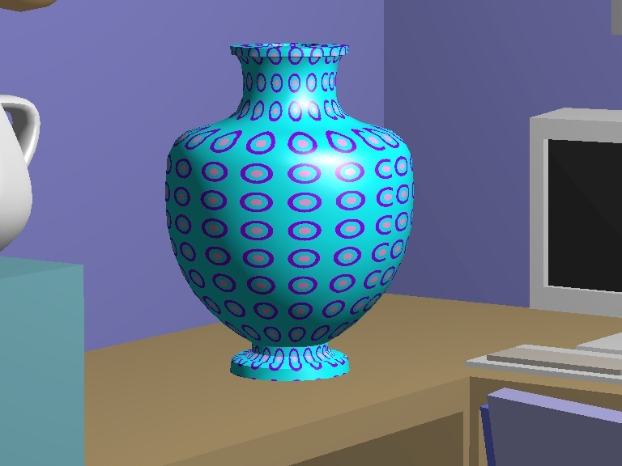
Cylinder Mapping Example

Slide 20

Sphere Mapping Example

Slide 21
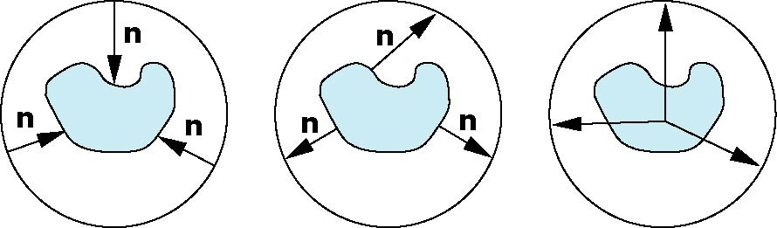
Second Mapping
Map from intermediate object to actual object
Normals from intermediate to actual
Normals from actual to intermediate
Vectors from center of intermediate
actual
intermediate

Slide 22
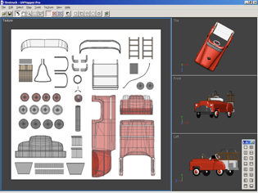
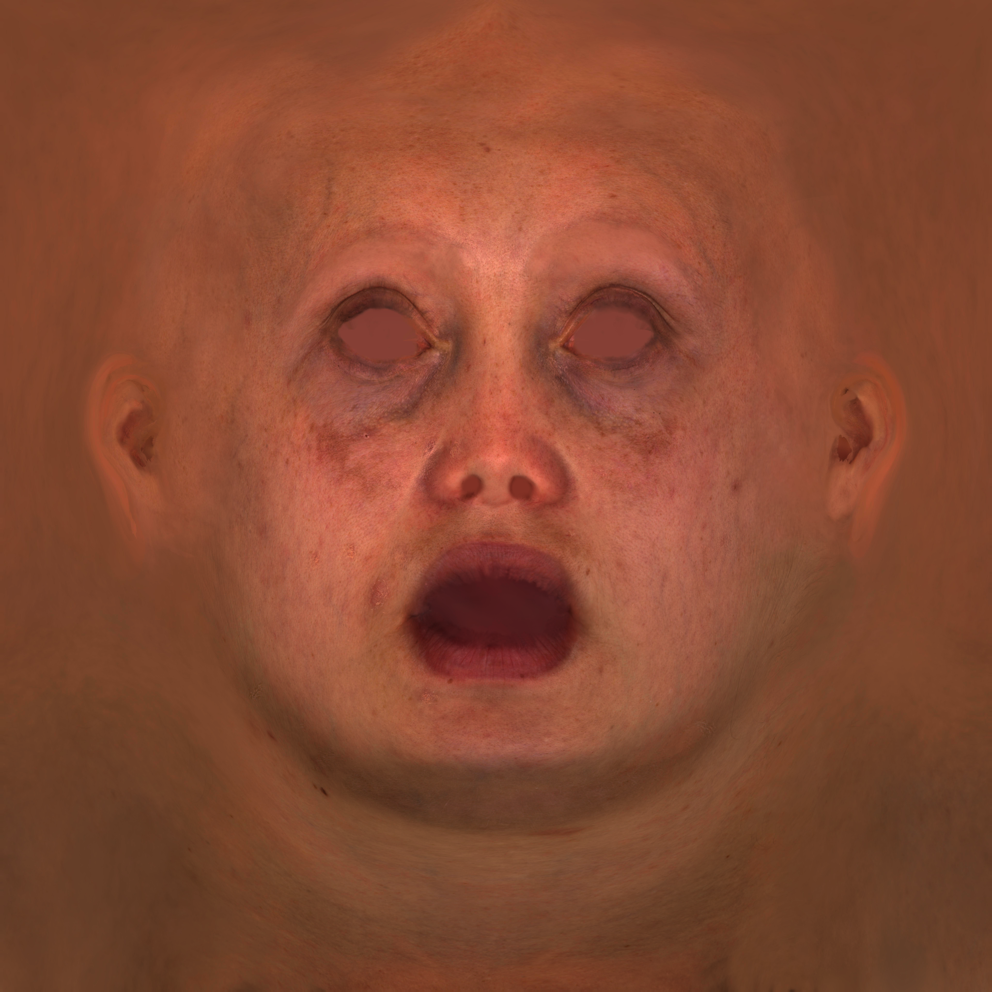
In Practice
The world is concave.

Slide 23
In Practice
Texture coordinates are
Generated very sophisticated algorithm
Minimizing distortion
Optimizing mapping between triangle sizes in model and texture image
Stored in file
Textures are packed into a single image

Slide 24
Practical Texture Mapping
Usual textures
Diffuse map: color of object
Specular map: intensity (and color) of specular component
Normal map(or bump map): geometric perturbation
Optional
Ambient occlusion map
A narrow valley is darker
Baked off-line
Displacement map
“Geometric” perturbation larger than normal map
Glossiness map: partial shininess
Many others
All spatially varying properties

Slide 25
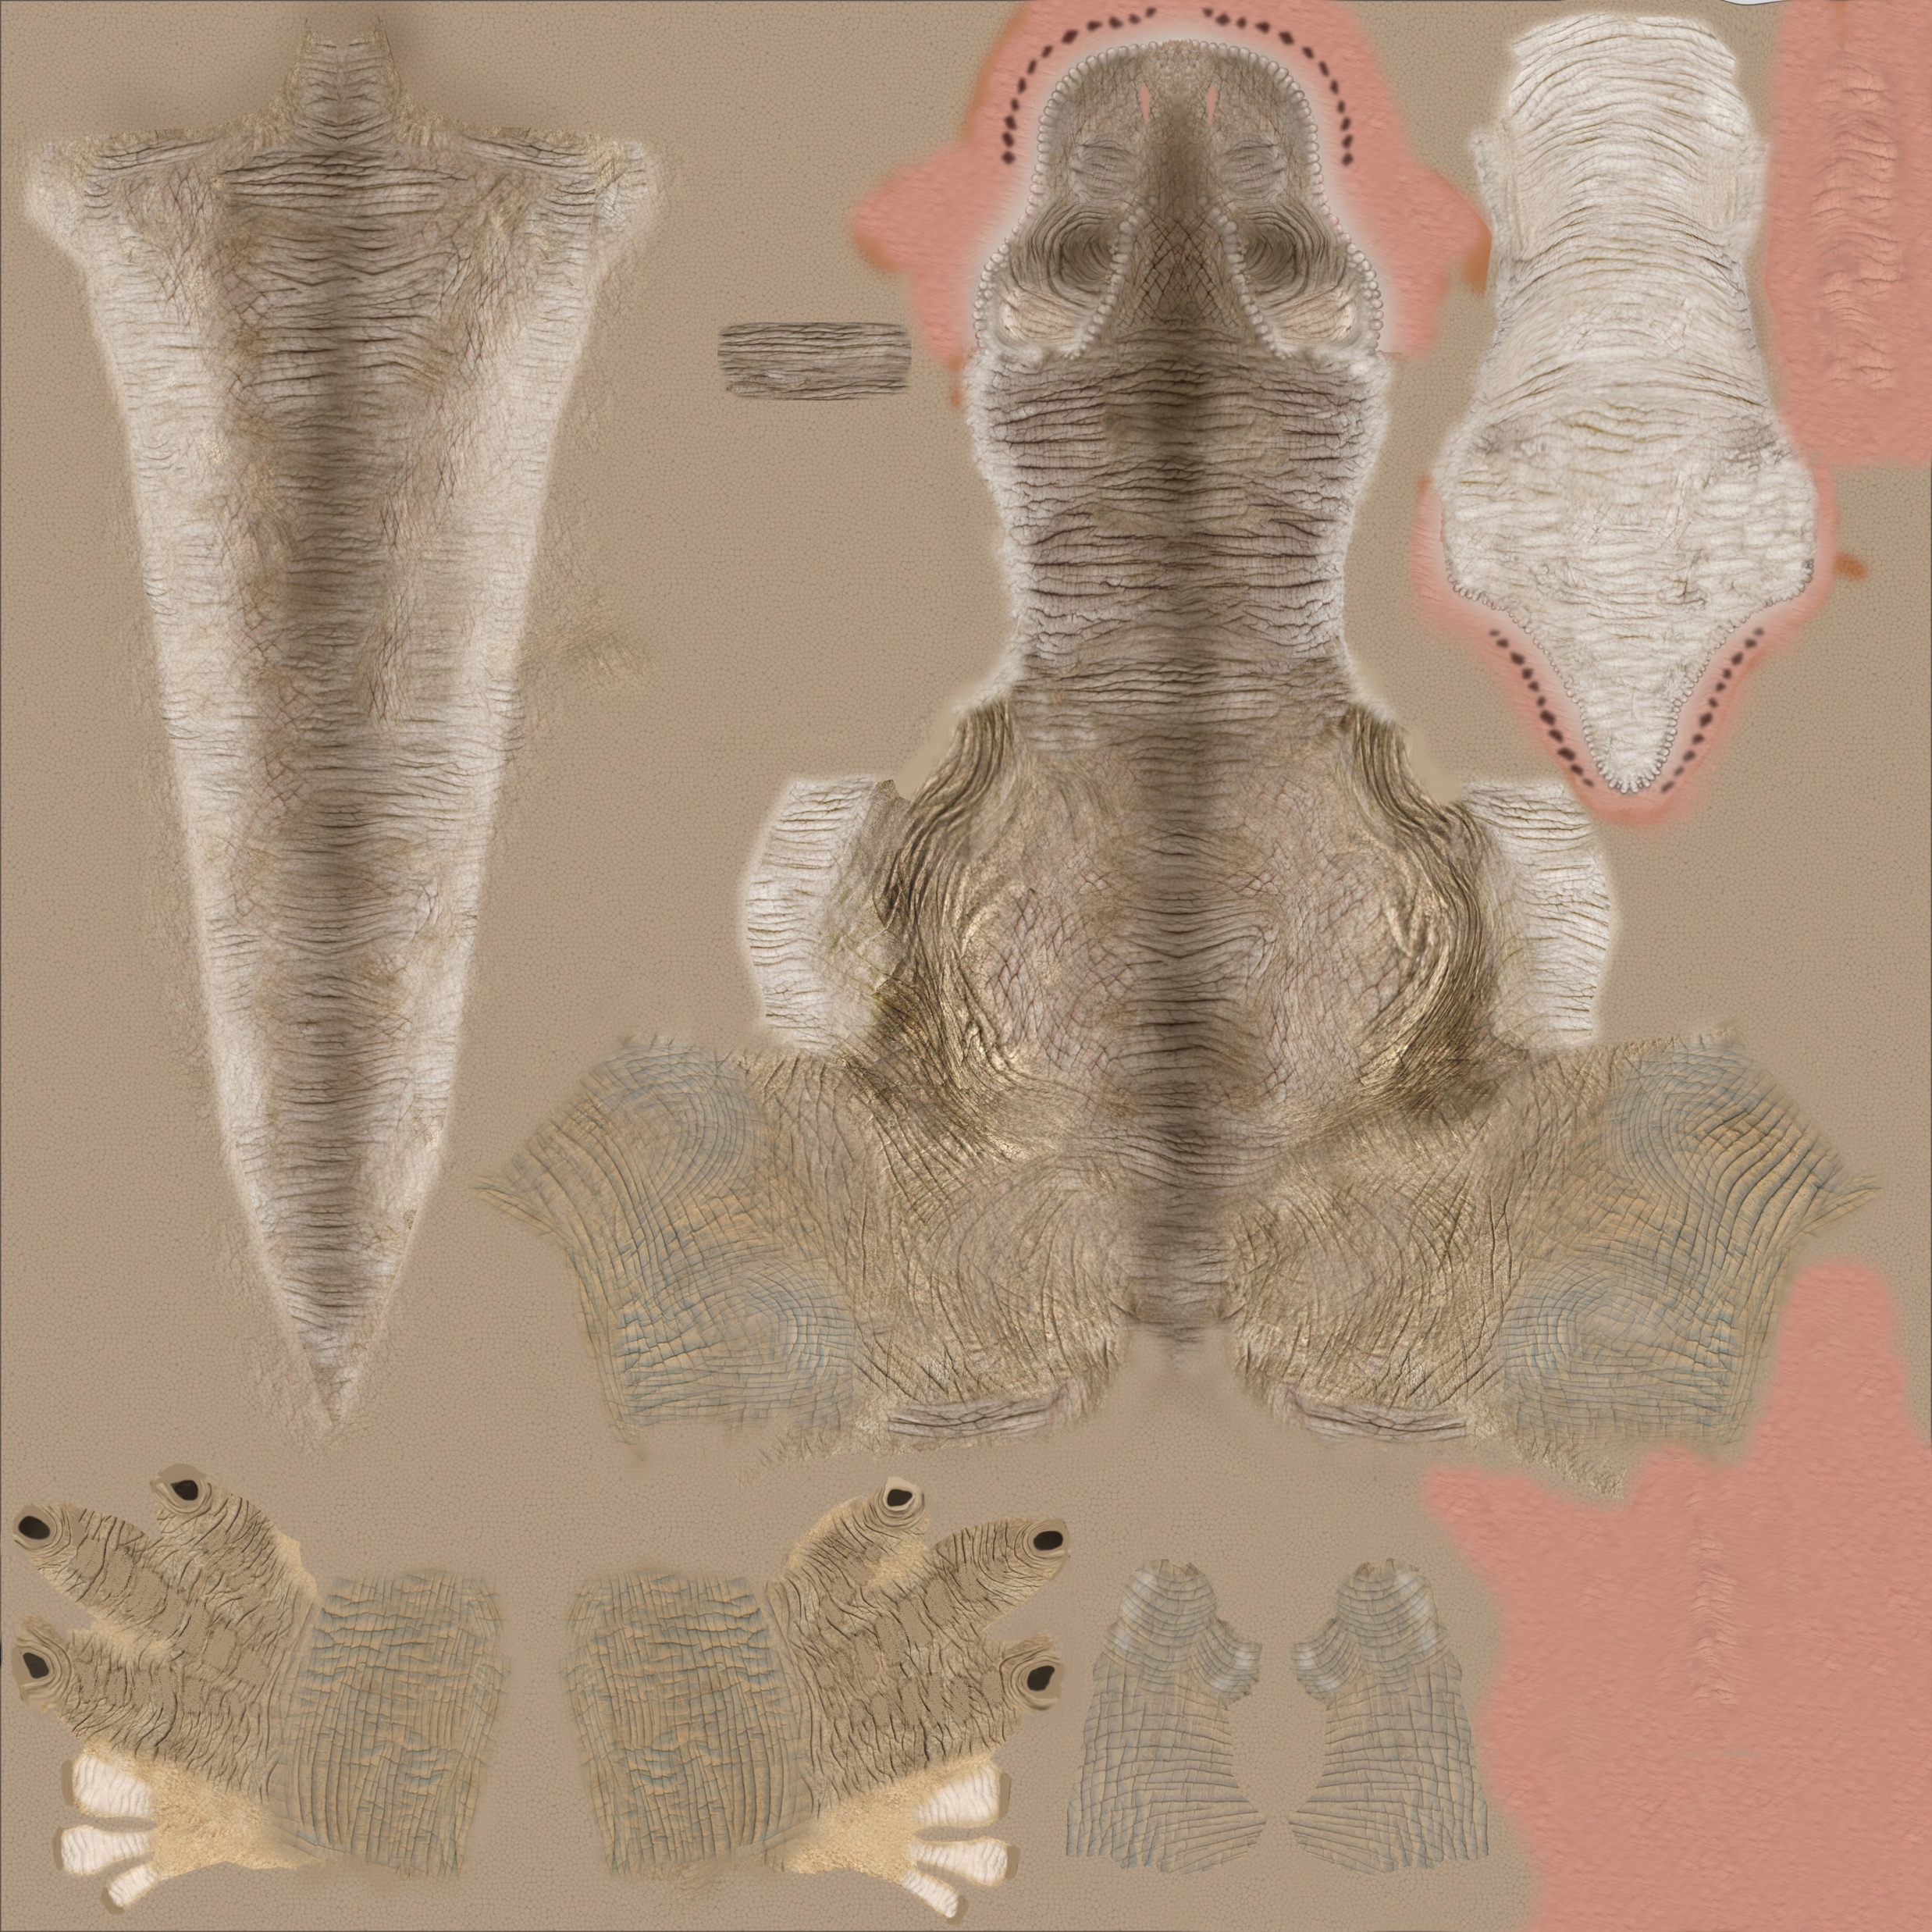
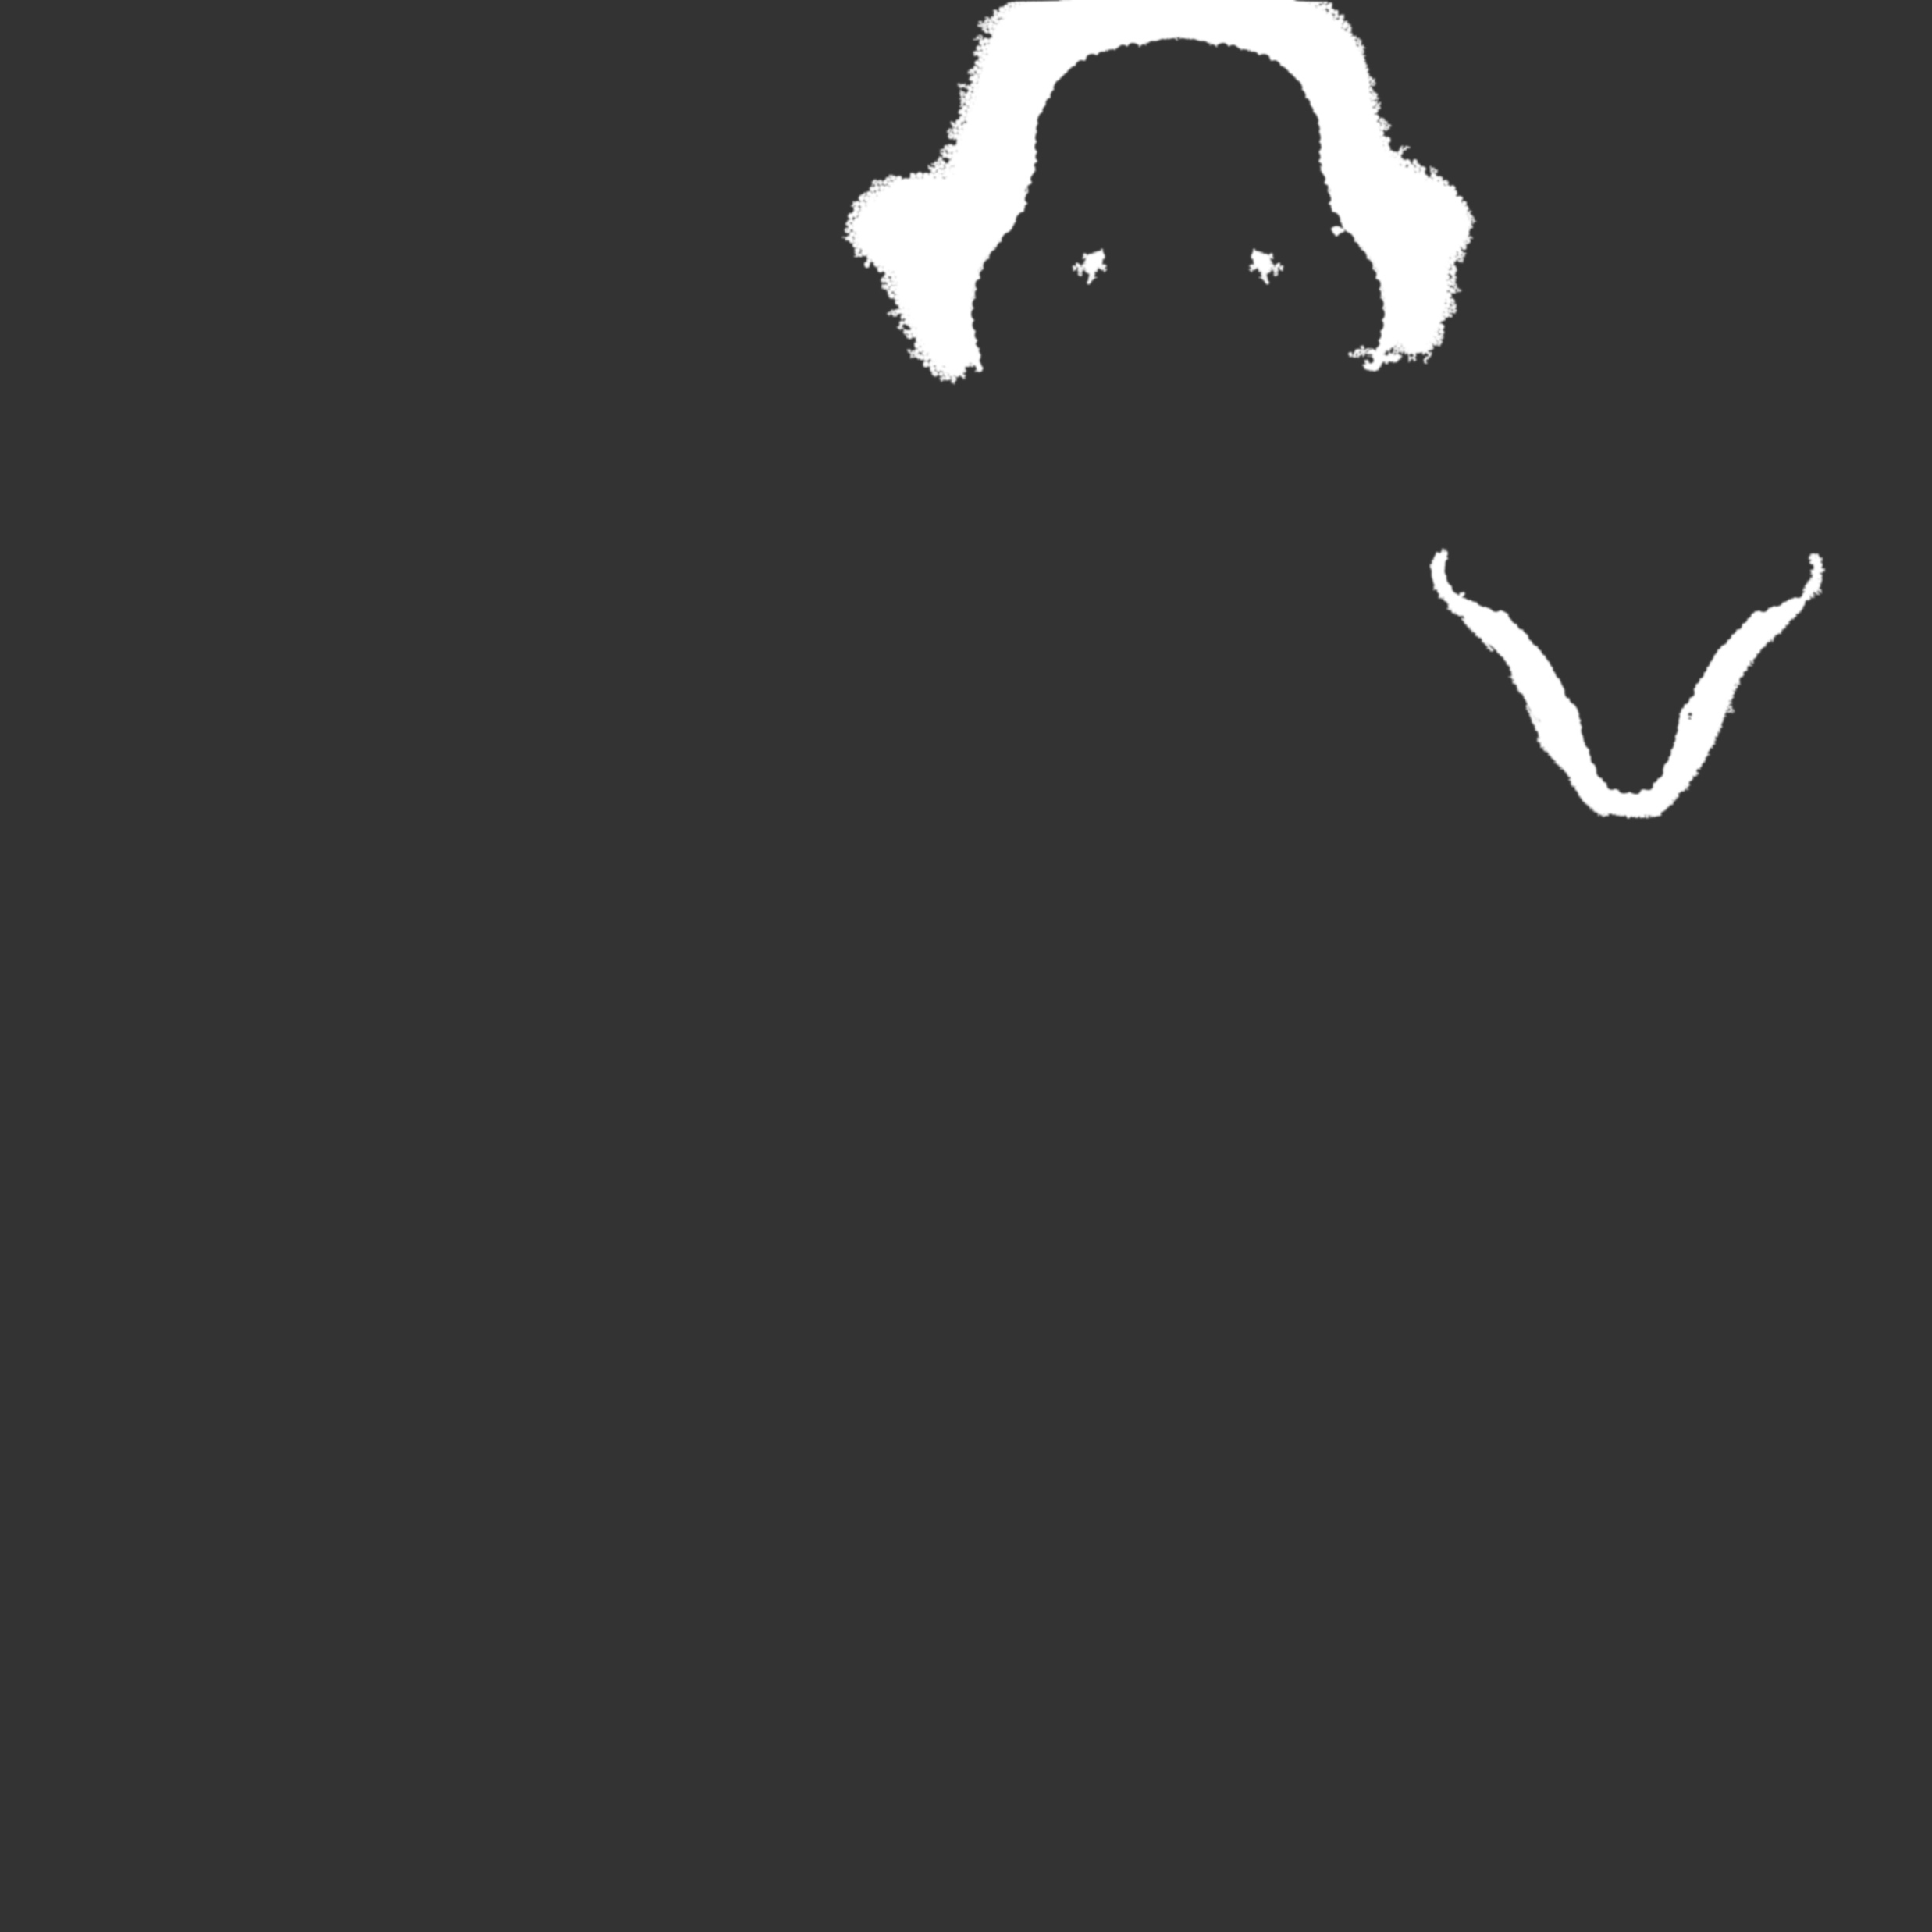
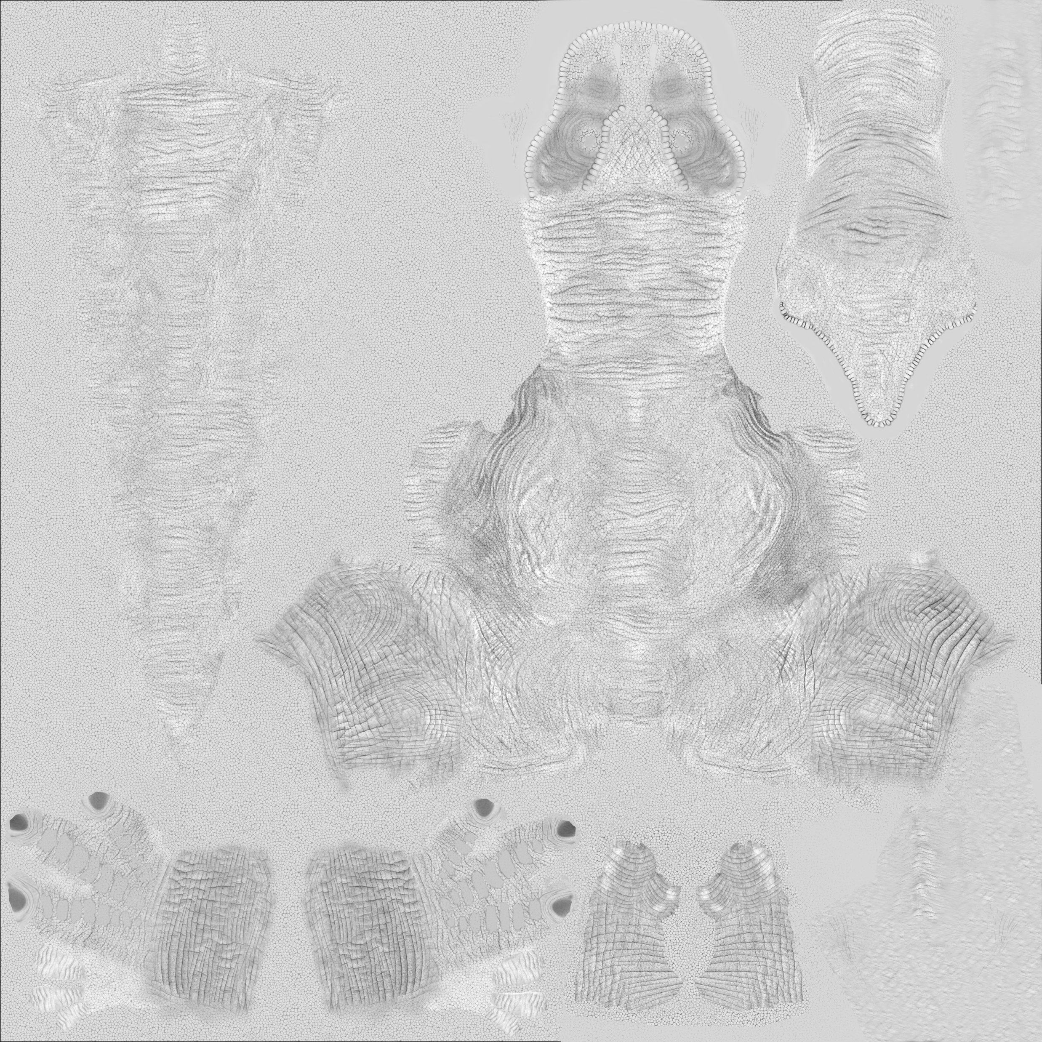
Practical Texture Mapping
T-rex

Slide 26
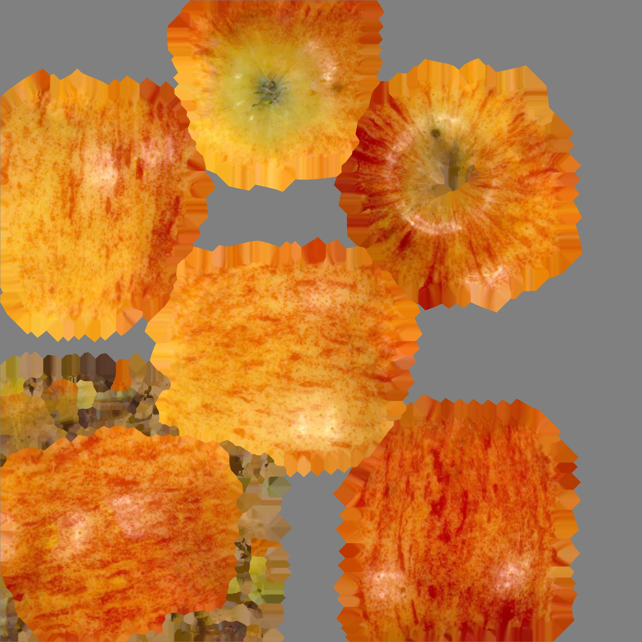

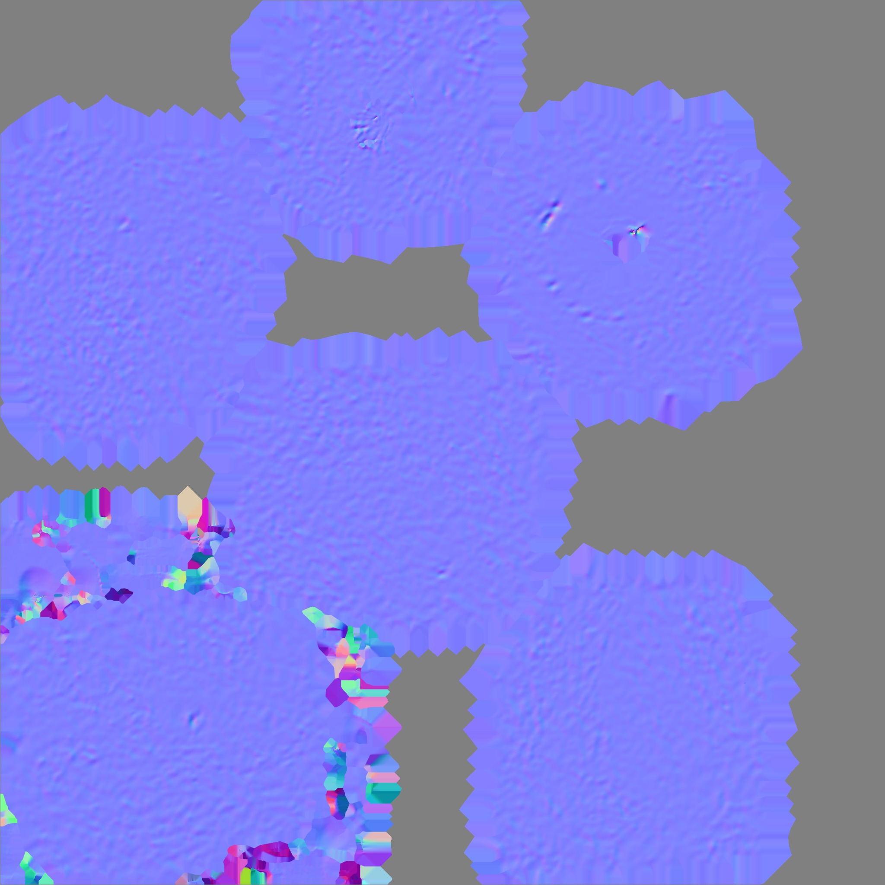
Practical Texture Mapping
Apple

Slide 27
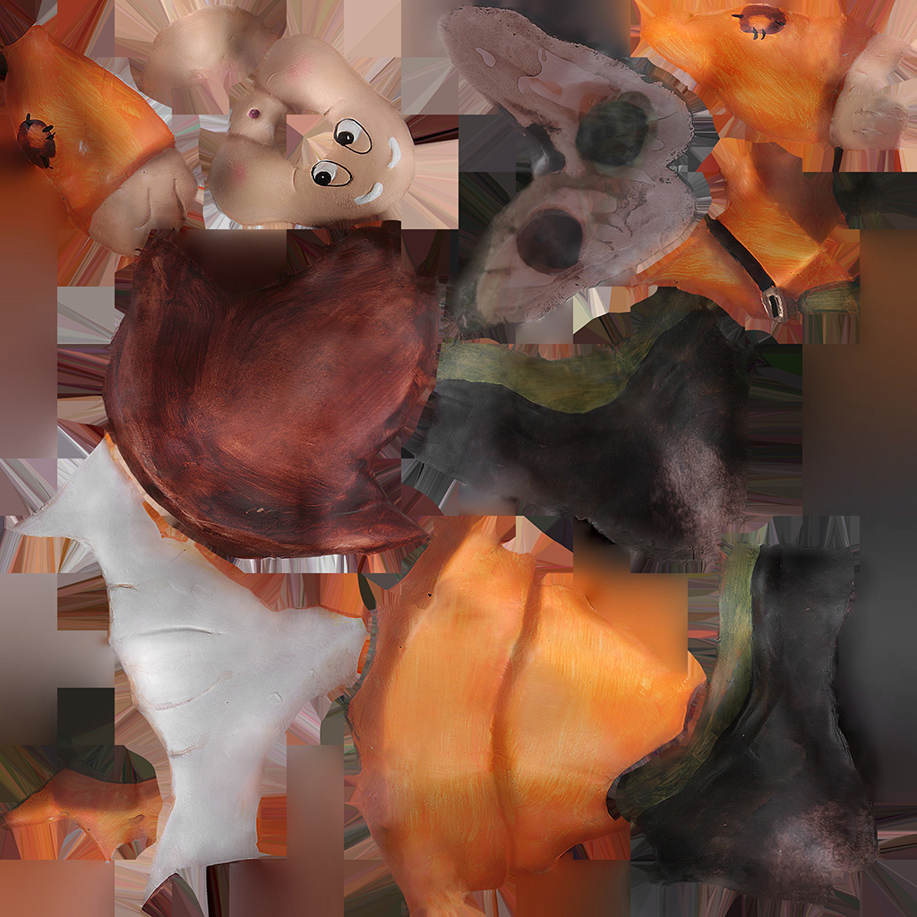
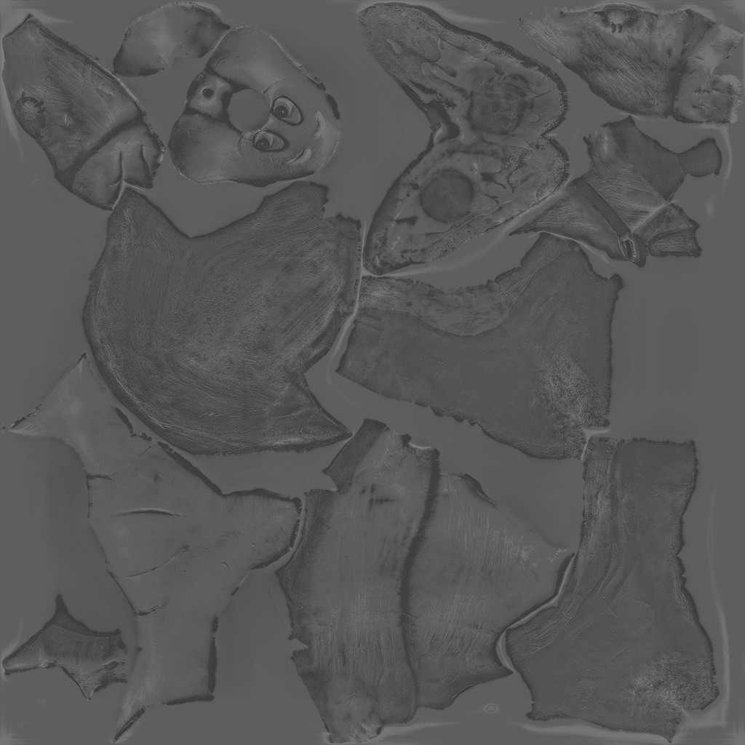
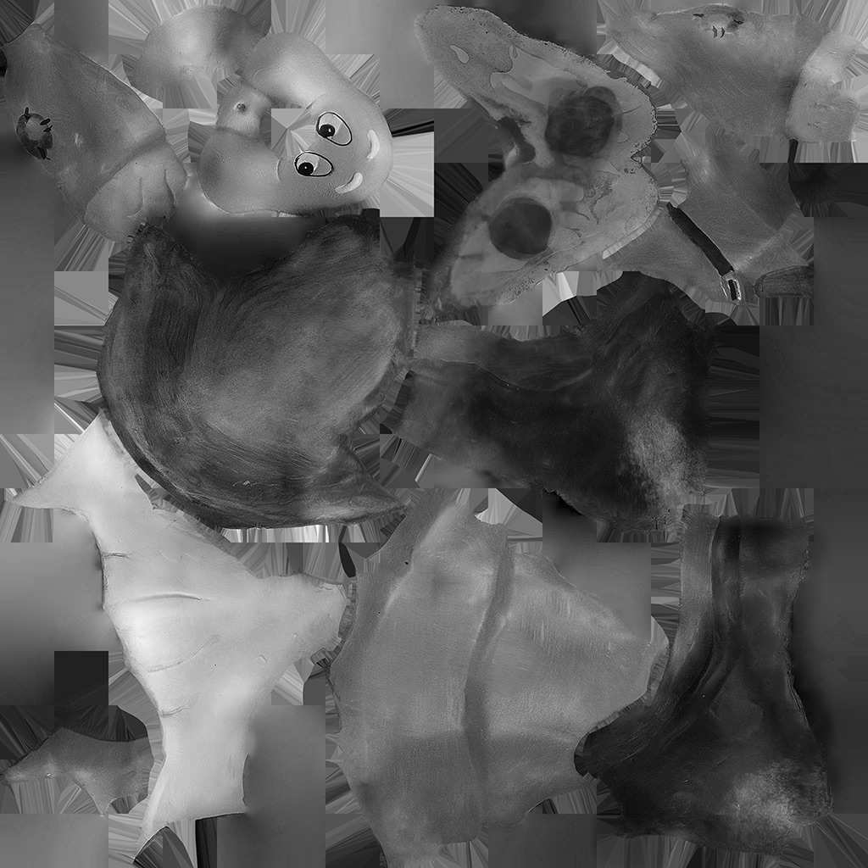
Practical Texture Mapping
Dwarf

Slide 28
Textures in OpenGL
Textures are stored in Graphics memory (in Video card)
Managed by ID
OpenGL supports
2D texture (GL_TEXTURE_2D)
3D texture (GL_TEXUTRE_3D)
1D texture (GL_TEXTURE_1D)
Multiple texture slots
Many texture can be used at a time

Slide 29
Texture Creation
Loading image from a file
Nice, kind, simple 3rd party program called stb_image
int w=0, h=0, n=0;
void* buf = stbi_load(“Filename.jpg”, &w, &h, &n, 0);
// or void* buf = stbi_load(“Filename.jpg”, &w, &h, &n, 4);
// w: width
// h: height
// n: number of channels
// buf: the memory that stores all pixels
// Upload texture here
stbi_image_free( buf );

Slide 30
Texture Creation in OpenGL
Typical Scenario
glGenTextures( 1, &textureID );
glBindTexture( GL_TEXTURE_2D, textureID );
glTexParameteri( GL_TEXTURE_2D, GL_TEXTURE_MIN_FILTER, GL_LINEAR );
glTexParameteri( GL_TEXTURE_2D, GL_TEXTURE_MAG_FILTER, GL_LINEAR);
glTexParameteri( GL_TEXTURE_2D, GL_TEXTURE_WRAP_S, GL_REPEAT);
glTexParameteri( GL_TEXTURE_2D, GL_TEXTURE_WRAP_T, GL_REPEAT);
glTexImage2D( GL_TEXTURE_2D, 0, internalFormat, width, height, 0, format, dataType, data);

Slide 31
Texture Creation in OpenGL
Internal Format
How pixels are stored in video memory
Typically GL_RGB or GL_RGBA
Sometimes, GL_RGB32F, GL_RGBA32F
Since the image is in sRGB color space: GL_SRGB8 or GL_SRGB_ALPHA8
Format
How the data we send are stored
Typically GL_RGBA
Data Type
What is the data type of each pixel channel
Typically GL_UNSIGNED_BYTE

Slide 32
Texture Creation in OpenGL
Final Code
Read image from the file
int w=0, h=0, n=0;
void* buf = stbi_load( “Filename.jpg”, &w, &h, &n, 4); // n must be 4
Generate texture & set parameters
glGenTextures( 1, &textureID );
glBindTexture( GL_TEXTURE_2D, textureID );
glTexParameteri( GL_TEXTURE_2D, GL_TEXTURE_MIN_FILTER, GL_LINEAR );
glTexParameteri( GL_TEXTURE_2D, GL_TEXTURE_MAG_FILTER, GL_LINEAR);
glTexParameteri( GL_TEXTURE_2D, GL_TEXTURE_WRAP_S, GL_REPEAT);
glTexParameteri( GL_TEXTURE_2D, GL_TEXTURE_WRAP_T, GL_REPEAT);
Send data & delete buffer
glTexImage2D( GL_TEXTURE_2D, 0, GL_SRGB8_ALPHA8, w, h, 0, GL_RGBA, GL_UNSIGNED_BYTE, buf);
stbi_image_free( buf );

Slide 33
Using Texture
Choose which slot the texture is bound
glActiveTexture( GL_TEXTURE0 + activeSlot );
Bind texture to the slot
glBindTexture( GL_TEXTURE_2D, textureID );
Notify the slot to the shader
GLint loc = glGetUniformLocation(program, “diffTex” );
glUniform1i(loc, activeSlot);

Slide 34
Using Texture in Fragment Shader
Texture uniform variable
uniform sampler2D diffTex;
Sampling texture
vec4 diffColor = texture( diffTex, textureCoord );
// Or course textureCoord must be sent from the vertex shader.
Note
The texture value is interpolated when you set GL_TEXTURE_MIN_FILTER and GL_TEXTURE_MAG_FILTER as GL_LINEAR.

Slide 35
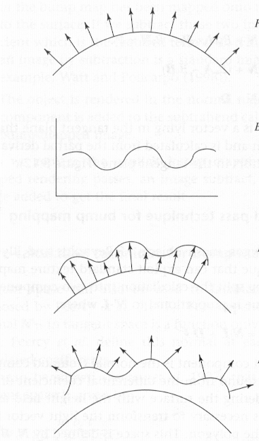
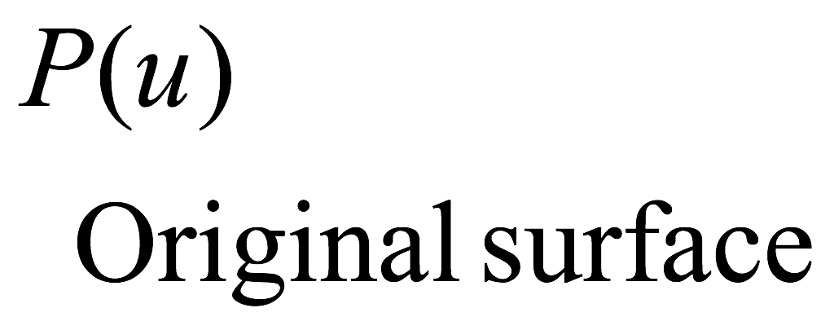
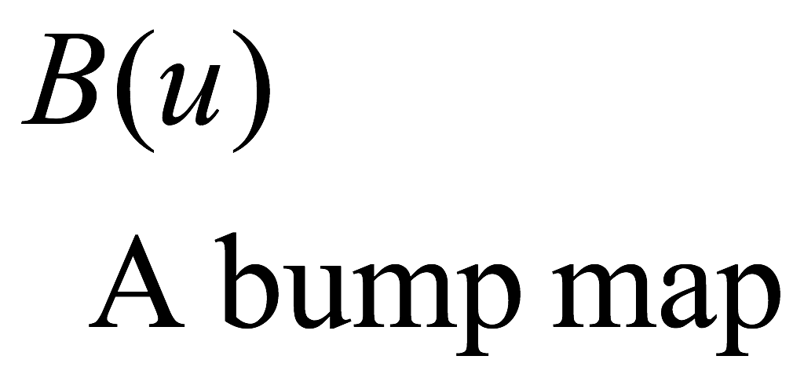
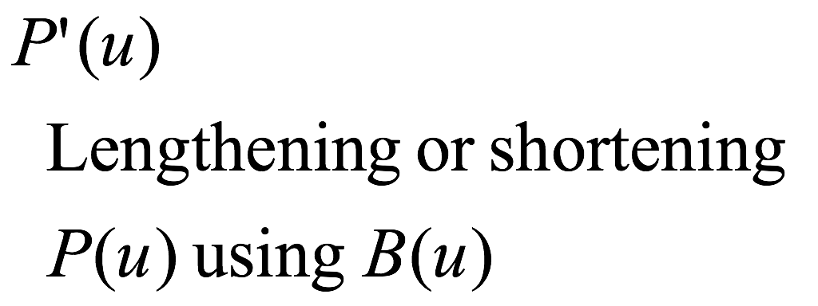
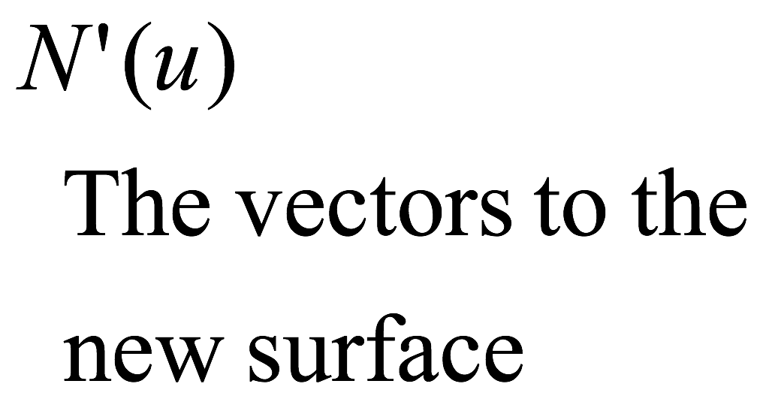
Bump Mapping

Slide 36
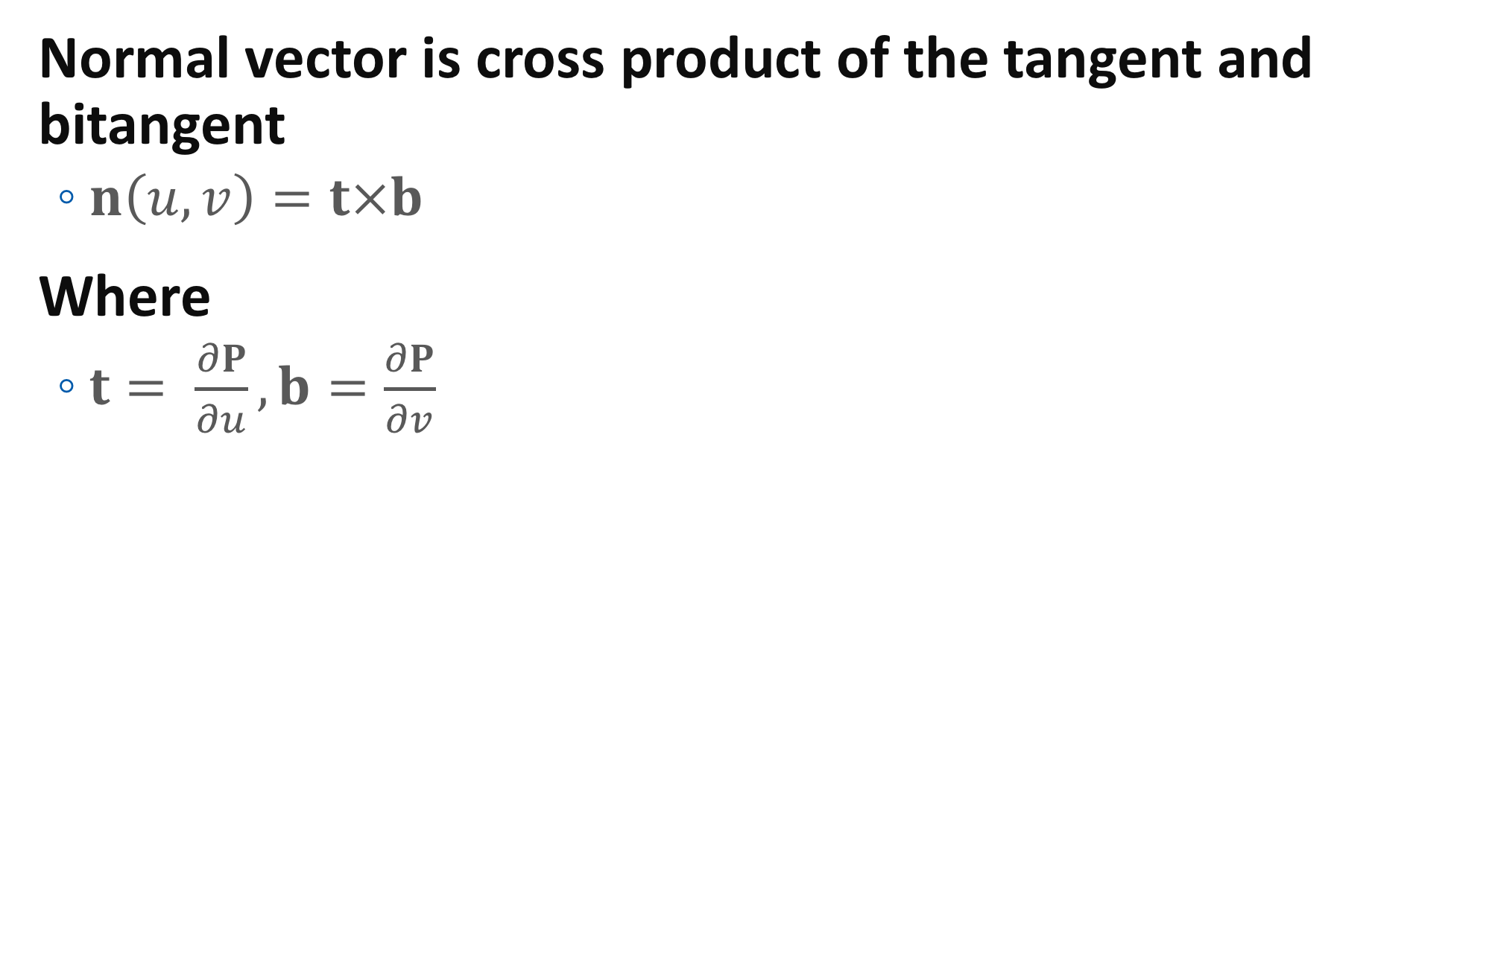
Bump Mapping
Normal vector is cross product of the tangent and bitangent
$n\left(u,v\right)=t×b$
Where
$t= \frac{∂P}{∂u},b=\frac{∂P}{∂v}$

Slide 37
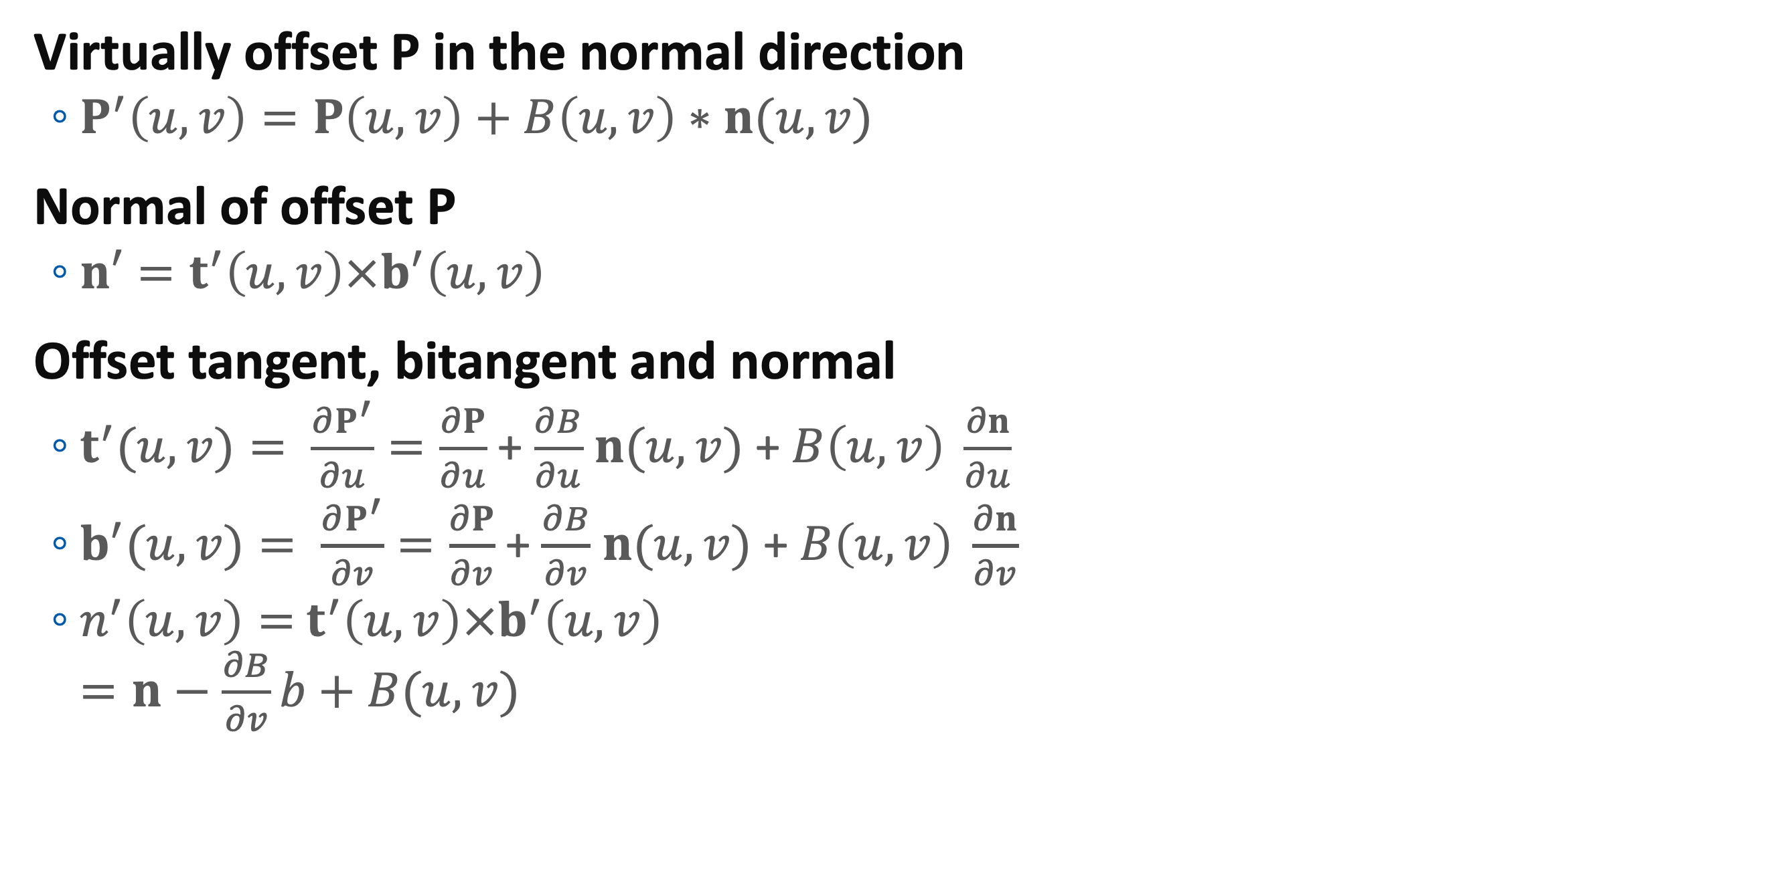
Bump Mapping
Virtually offset P in the normal direction
$P^{′}\left(u,v\right)=P\left(u,v\right)+B\left(u,v\right)∗n(u,v)$
Normal of offset P
$n′=t^{′}\left(u,v\right)×b^{′}\left(u,v\right)$
Offset tangent, bitangent and normal
$t^{′}(u,v)= \frac{∂P^{′}}{∂u}=\frac{∂P}{∂u}$ + $\frac{∂B}{∂u}$ $n(u,v)$+ $B\left(u,v\right) \frac{∂n}{∂u}$
$b^{′}(u,v)= \frac{∂P^{′}}{∂v}=\frac{∂P}{∂v}$ + $\frac{∂B}{∂v}$ $n(u,v)$+ $B\left(u,v\right) \frac{∂n}{∂v}$
$n^{′}\left(u,v\right)=$ $t^{′}\left(u,v\right)×b^{′}\left(u,v\right)$ $=n−$ $\frac{∂B}{∂v}b+B(u,v)$

Slide 38
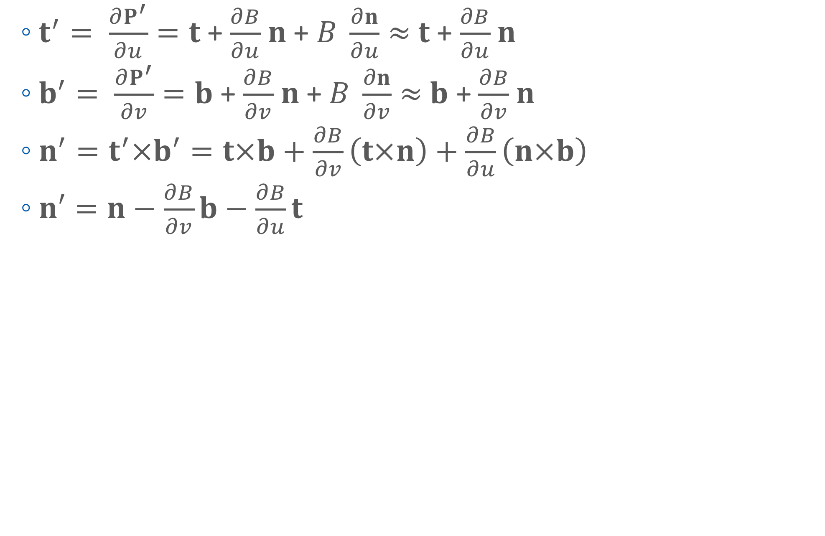
Bump Mapping
$t^{′}= \frac{∂P^{′}}{∂u}=t$ + $\frac{∂B}{∂u}$ $n$+ $B \frac{∂n}{∂u}≈$ $t$ + $\frac{∂B}{∂u}$ $n$
$b^{′}= \frac{∂P^{′}}{∂v}=b$ + $\frac{∂B}{∂v}$ $n$+ $B \frac{∂n}{∂v}≈$ $b$ + $\frac{∂B}{∂v}$ $n$
$n^{′}=t^{′}×b^{′}=t×b+\frac{∂B}{∂v}\left(t×n\right)+\frac{∂B}{∂u}\left(n×b\right)$
$n′=n−\frac{∂B}{∂v}b−\frac{∂B}{∂u}t$

Slide 39

How We Compute Tangent and Bitangent
In triangle
$E_{1}=∆U_{1}t+∆V_{1}b={∆P}_{1}$
$E_{2}=∆U_{2}t+∆V_{2}b={∆P}_{2}$
Therefore
$\left[\begin{matrix}∆P_{1}^{x} & ∆P_{1}^{y} & ∆P_{1}^{z} \\ ∆P_{2}^{x} & ∆P_{2}^{y} & ∆P_{2}^{z}\end{matrix}\right]=\left[\begin{matrix}∆U_{1} & ∆V_{1} \\ ∆U_{2} & ∆V_{2}\end{matrix}\right]$ $\left[\begin{matrix}t_{x} & t_{y} & t_{z} \\ b_{x} & b_{y} & b_{z}\end{matrix}\right]$

Slide 40

How We Compute Tangent and Bitangent
$\left[\begin{matrix}∆P_{1}^{x} & ∆P_{1}^{y} & ∆P_{1}^{z} \\ ∆P_{2}^{x} & ∆P_{2}^{y} & ∆P_{2}^{z}\end{matrix}\right]=\left[\begin{matrix}∆U_{1} & ∆V_{1} \\ ∆U_{2} & ∆V_{2}\end{matrix}\right]$ $\left[\begin{matrix}t_{x} & t_{y} & t_{z} \\ b_{x} & b_{y} & b_{z}\end{matrix}\right]$
${\left[\begin{matrix}∆U_{1} & ∆V_{1} \\ ∆U_{2} & ∆V_{2}\end{matrix}\right]}^{−1}\left[\begin{matrix}∆P_{1}^{x} & ∆P_{1}^{y} & ∆P_{1}^{z} \\ ∆P_{2}^{x} & ∆P_{2}^{y} & ∆P_{2}^{z}\end{matrix}\right]=\left[\begin{matrix}t_{x} & t_{y} & t_{z} \\ b_{x} & b_{y} & b_{z}\end{matrix}\right]$
2x2 matrix inversion is trivial

Slide 41

How We Compute Tangent and Bitangent
Screen Space Approach
OpenGL provides functions to compute “screen space” derivatives: dFdx( something ), dFdy( something)
ex) dFdx( worldPos ) = $\frac{∂P}{∂x}$
Rewriting
${\left[\begin{matrix}∆U_{1} & ∆V_{1} \\ ∆U_{2} & ∆V_{2}\end{matrix}\right]}^{−1}\left[\begin{matrix}∆P_{1}^{x} & ∆P_{1}^{y} & ∆P_{1}^{z} \\ ∆P_{2}^{x} & ∆P_{2}^{y} & ∆P_{2}^{z}\end{matrix}\right]=\left[\begin{matrix}t_{x} & t_{y} & t_{z} \\ b_{x} & b_{y} & b_{z}\end{matrix}\right]$
${\left[\begin{matrix}\frac{∂u}{∂x} & \frac{∂v}{∂x} \\ \frac{∂u}{∂y} & \frac{∂v}{∂y}\end{matrix}\right]}^{−1}\left[\begin{matrix}\frac{∂P_{x}}{∂x} & \frac{∂P_{y}}{∂x} & \frac{∂P_{z}}{∂x} \\ \frac{∂P_{x}}{∂x} & \frac{∂P_{y}}{∂y} & \frac{∂P_{z}}{∂z}\end{matrix}\right]=\left[\begin{matrix}t_{x} & t_{y} & t_{z} \\ b_{x} & b_{y} & b_{z}\end{matrix}\right]$

Slide 42

Real GLSL Code
Equation
${\left[\begin{matrix}\frac{∂u}{∂x} & \frac{∂v}{∂x} \\ \frac{∂u}{∂y} & \frac{∂v}{∂y}\end{matrix}\right]}^{−1}\left[\begin{matrix}\frac{∂P_{x}}{∂x} & \frac{∂P_{y}}{∂x} & \frac{∂P_{z}}{∂x} \\ \frac{∂P_{x}}{∂x} & \frac{∂P_{y}}{∂y} & \frac{∂P_{z}}{∂z}\end{matrix}\right]=\left[\begin{matrix}t_{x} & t_{y} & t_{z} \\ b_{x} & b_{y} & b_{z}\end{matrix}\right]$
TBN matrix
mat3 getTBN( vec3 N ) {
vec3 Q1 = dFdx(posWorld), Q2 = dFdy(posWorld);
vec2 st1 = dFdx(texCoord), st2 = dFdy(texCoord);
float D = st1.s*st2.t-st2.s*st1.t;
return mat3(normalize(( Q1*st2.t - Q2*st1.t )*D),
normalize((-Q1*st2.s + Q2*st1.s )*D), N);
}

Slide 43

Bump Mapping in GLSL
Equation
$n′=n−\frac{∂B}{∂v}b−\frac{∂B}{∂u}t$
Corresponding Code
mat3 TBN = getTBN( N );
float Bu = texture( normalTex, tCoord+vec2(TEX_DELTA,0) ).r
- texture( normalTex, tCoord-vec2(TEX_DELTA,0) ).r;
float Bv = texture( normalTex, tCoord+vec2(0,TEX_DELTA) ).r
- texture( normalTex, tCoord-vec2(0,TEX_DELTA) ).r;
vec3 bumpVec = vec3(-Bu*15., -Bv*15., 1 );
N = normalize( TBN* bumpVec );

Slide 44

Bump Mapping Example - 1

Slide 45


Bump Mapping Example - 2

Slide 46



Bump Mapping Example - 3

Slide 47



Bump Mapping Example - 4

Slide 48


Normal Mapping
Precompute weight vector
bumpVec in the previous code
Red: more tangent
Green: more bitangent
Blue: normal
Since the weight can be negative, …

Slide 49
Normal Mapping in GLSL
Real Code
mat3 TBN = getTBN( N );
vec3 normalOffset = texture( normalTex, texCoord ).rgb*2-1;
N = normalize( TBN*normalOffset );

Slide 50
Environment Mapping
Reflection mapping first suggested by Blinn and Newell (1976)
Environment mapping by Greene (1986)
Rendering shiny objects that reflect the environment
Disadvantages
Correct only when the object becomes small
No self-reflection
A separate map required for each object
A new map is required whenever the view point changes in sphere mapping

Slide 51


Environment Mapping (General Concept)

Slide 52

Cubic Mapping - 1
Cubic map convention

Slide 53
Application
“Matte” an animated computer graphics object into a real environment
Photographs of a real environment : used as environment map
Specular computer graphics object can be matted into the scene (reflects its surroundings)

Slide 54



Aliasing Problem

Slide 55

Anti-aliasing and Texture Mapping
Mip-Mapping approximation
Williams (1983)

Slide 56


Mip-Mapping Idea

Slide 57
Mip-Mapping in OpenGL
When you create texture map,
glTexParameteri( GL_TEXTURE_2D, GL_TEXTURE_MIN_FILTER, GL_LINEAR_MIPMAP_LINEAR);
glTexParameteri( GL_TEXTURE_2D, GL_TEXTURE_MAG_FILTER, GL_LINEAR);
glTexParameteri( GL_TEXTURE_2D, GL_TEXTURE_WRAP_S, GL_REPEAT);
glTexParameteri( GL_TEXTURE_2D, GL_TEXTURE_WRAP_T, GL_REPEAT);
glTexImage2D( GL_TEXTURE_2D, 0, internalFormat, width, height, 0, format, dataType, data);
glGenerateMipmap( GL_TEXTURE_2D );
OpenGL automatically chooses the best mipmap level.

Slide 58


Anisotropic Filtering
Problem of Mipmap
What if X-Y mipmap level is different?
Cause blurry image

Slide 59
Anisotropic Filtering
Anisotropic mapping
Independent mipmap level for u-v axes

Slide 60

Anisotropic Filtering

Slide 61
Anisotropic Filtering in OpenGL
Simply set texture parameter
….
glTexParameteri( GL_TEXTURE_2D, GL_TEXTURE_WRAP_T, GL_REPEAT);
glTexParameterf( GL_TEXTURE_2D, GL_TEXTURE_MAX_ANISOTROPY_EXT, 8);
glTexImage2D( GL_TEXTURE_2D, 0, internalFormat, width, height, 0, format, dataType, data);
glGenerateMipmap( GL_TEXTURE_2D );
…

Slide 62



Homework #5
Add Texture & Bump Mapping on T-rex

Slide 63
Homework #5
Procedure Brief
Load Trex_m.j3a
Load TrexColor00150215.jpg & TrexBump012714.jpg
As in diffuseMap[0], and bumpMap[0]
Create OpenGL texture for them
Create and fill data for texture coordinate buffer
texCoords[0]
Of course, you connect it to “vertex array”
Get texture coordinate in vertex shader and send it to frag shader
v coordinate should be reversed
In frag shader, get texture coordinate, compute diffuse color from texture and do bump mapping as in the slide.
Perform Phong shading with the diffuse color and the perturbed normal.

